Slide 1
A Brief Summary of Radio Occultation with Global Navigation Satellite Systems (GNSS-RO)
John Braun
Acknowledgments Specifically to Jan Weiss, Zhen Zeng, Sergey Sokolovskiy, Rick Anthes,

Slide 2
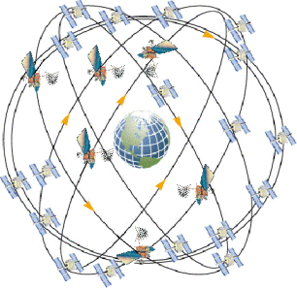
Outline
Brief description of GPS and GNSS characteristics
Basics of radio occultation (RO)
Refractivity
Bending angle
Geometric optics
Wave optics
RO errors and observation characteristics
RO applications
Notes:
Start by talking about the US GPS: including modernization plans and status
Review some fundamentals of satellite navigation and some specific examples of how satellite navigation works based on GPS signals as an example.
Other GNSS Systems (current and planned) - High level due to time constraints
This talk provides background for some of the subsequent talks that get into the use of satellite navigation systems for precise time transfer applications...

Slide 3
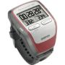
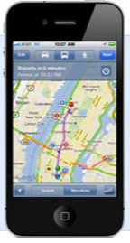
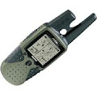
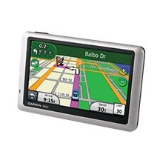
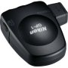
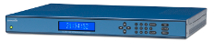
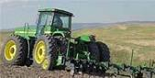
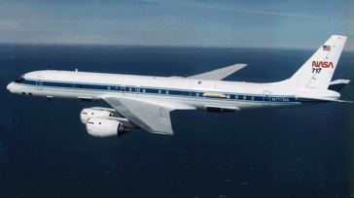
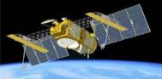
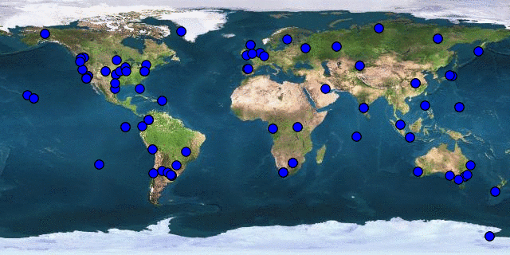
Applications of Satellite Navigation are Everywhere...
Military
Civilian
Transportation
Public services
Precise machine control
Timing and frequency
Surveying
Surveillance
Recreational
Space
Scientific applications
US spends annually about $1.5B+ on GPS
Annual direct economic benefit has been estimated at about $70B, 0.4% GDP
www.gps.gov/governance/advisory/meetings/2015-06/leveson.pdf
Notes:
GPS devices are literally everywhere today. Even if you don’t have a handheld device like this one, you probably use GPS indirectly every day through the use of cellular phone networks, ATM transactions, etc. Also wide range of scientific applications from the precise positioning of science instruments on satellites and airplanes, definition of the terrestrial reference frame, plus agriculture. Also critical for the US Department of Defense, but represents small fraction of the users.
The market for consumer GPS devices is on the order of 10’s of Billions of dollars per year and growing rapidly.T
Total bill of materials to add GPS to a phone is just a few dollars. (Host based GPS, 1000x sensitivity, cheap antennas) GPS in 300 to 500 M mobile phones (2010 number)
Now, imagine every receiver ever made since GPS was created 30 years ago: military and civilian, smart-bomb, boat, plane, hiking, survey, precision farming, GIS, Bluetooth-puck, personal digital assistant, and PND. In the last three years, we have put more GPS chips into mobile phones than the cumulative number of all other GPS receivers that have been built, ever! Frank van Diggelen, Dec 2009
Global Positioning Systems (GPS) Market Worldwide is Projected to Reach US$28.9 Billion by 2015, According to New Report by Global Industry Analysts, Inc.
(Oct 2010 Report by Global Industry Analysts, Inc.)
Current budget for GPS is approximately $1.4B, includes operation of the system, development, and launch of replacement satellites to maintain and improve the system.
2010 $1.1B
2009 $1.0B
Most of that (90% towards GPS III space and ground)

Slide 4
Importance of Precise Timing to GPS
Precise timing is fundamental to realizing high performance from satellite navigation systems
A typical GPS receiver provides user position estimates accurate to a few meters by measuring the range (signal delay) between the user and multiple GPS satellites
Assume the specified ranging error contribution from the satellite clock is one meter: one meter / speed of light = 3.3x10⁻⁹ s
GPS control segment predicts GPS clock performance over a 12 hour period (nominal frequency at which clock data is uploaded to the GPS satellites)
3.3 ns of 12 hours requires a clock with about one part in 10¹³ stability: 3.3x10⁻⁹ s / 43200 s = 0.8x10⁻¹³
Notes:
Satellite navigation systems are a topic at this seminar because precise timing is fundamental to realizing the performance we have come to expect from GPS and other systems
Typical GPS receivers determine user position accurate to a few meters by measuring range or signal delay to several satellites …
Direct relationship between time and measurement of range 1 meter range error = 3.3 ns

Slide 5
Atomic Clocks in Space
GPS satellites carry redundant rubidium or cesium oscillators (or a combination)
Precise frequency standard provides a reference for generating the ranging signals transmitted by the satellites
Clocks on the satellites are synchronized to GPS time which is coarsely steered by GPS ground controllers to Coordinated Universal Time (UTC) as maintained by the US Naval Observatory (USNO)
A direct reference to UTC(USNO) can be made automatically by most timing receivers by using corrections included in the broadcast GPS NAV message.
By mutual agreement, UTC(USNO) and UTC(NIST) are maintained within 100ns, but in practice much closer.
Traceability to UTC(USNO) enables precise time and frequency transfer on a global scale.
Notes:
This level of performance requires an atomic frequency standard.
One of the innovations of GPS in the 1970’s was developing atomic clock technology that was both small enough to be integrated on a satellite and launched into space, and robust enough to survive years in the harsh environment of space.
GPS provides a link to the UTC time scale

Slide 6
Satellite Navigation Basic Principles
Satellite navigation is based on:
Precise synchronization of radio beacons
The constancy of the speed of light connecting signal transit-time to range regardless of relative motion
GPS and other systems use the concept of multi-lateration for position/time solution:
Satellite transmitter positions are known
Receiver position is unknown
Measured transit-time of signals constrains receiver position relative to transmitters
Notes:
GPS positioning is based on trilateration: estimation of position based on measurement of distances. Satellite (transmitter) positions are known, receiver position is unknown The distance between the transmitter and receiver is determined by measuring the transit time of the signal from satellite to user

Slide 7
Trilateration Example: 3 Transmitters, 1 Receiver
Receiver Location
Measurement of range requires precise knowledge of the time the signal is transmitted from the satellite, and received at the receiver
Range (ρ) or “time of flight” measurement is made using ranging code on the signal
ρ₃
T₃
ρ₂
ρ₁
T₁
T₂
Notes:
Simple two-dimensional example… Location of a transmitter is known, measurement of the range to the transmitter determines your position on this circle. Add a range measurement to a second transmitter constrains your location to these two points. Third transmitter uniquely determines position.
Measurement of range requires… These measurements performed measuring delay between the time ranging signal is transmitted by the satellite and received by the user receiver

Slide 8
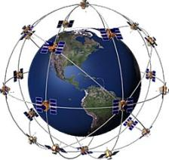
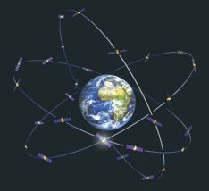
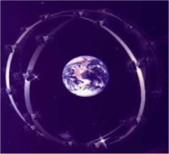
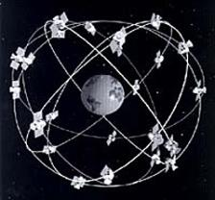
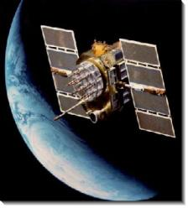
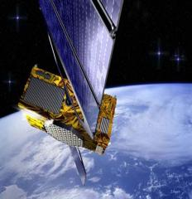
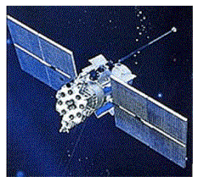
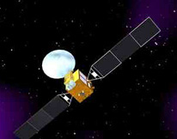
Global GNSS Constellations
GPS
US
(31)
Galileo
EU
(28)
GLONASS
Russia
(24)
Beidou/Compass
China
(44)
Notes:
Advances in positioning, navigation, and timing always bring with them advances in exploration. That was true for the explorers of the New World with new celestial instruments and chronometers as it is for this generation of explorers with the new global navigation satellites. It is not universally recognized, but the very significant international investments in Global Navigation Satellite Systems within this decade offers an important opportunity for the remote sensing of the Earth. GPS is about to begin the launch of satellites with new signal structures- L2C and L5. Galileo will begin the deployment of a multi-frequency satellite constellation in 2009. The Russian government has recommitted to the completion of the GLONASS constellation. The next decade could see a tripling of high precision satellite sources with enhanced robust multi-frequency signal structures. There is a developing interest in the utilization of these signals for the study of the Earth’s ionosphere, atmosphere, land and oceans using bistatic techniques. Utilization of this techniques provides a cost efficient and robust capability for Earth observation.
The two satellites (1A,1B) mentioned above were designed as experimental satellites; China has yet to build the remaining satellites to make Beidou an operational global positioning utility.
The new system will be a constellation of 35 satellites, which include 5 geostationary orbit (GEO) satellites and 30 medium Earth orbit (MEO) satellites, that will offer complete coverage of the globe. There will be two levels of service provided; free service for those in China, and licensed service for the military.
* The free service will have a 10 meter location-tracking accuracy, will synchronize clocks with an accuracy of 50 ns, and measure speeds within 0.2 m/s.
* The licensed service will be more accurate than the free service, can be used for communication, and will supply information about the system status to the users.
Two satellites for Beidou 2 have been launched in early 2007. In the next few years, China plans to continue experimentation and setup system operations.

Slide 9
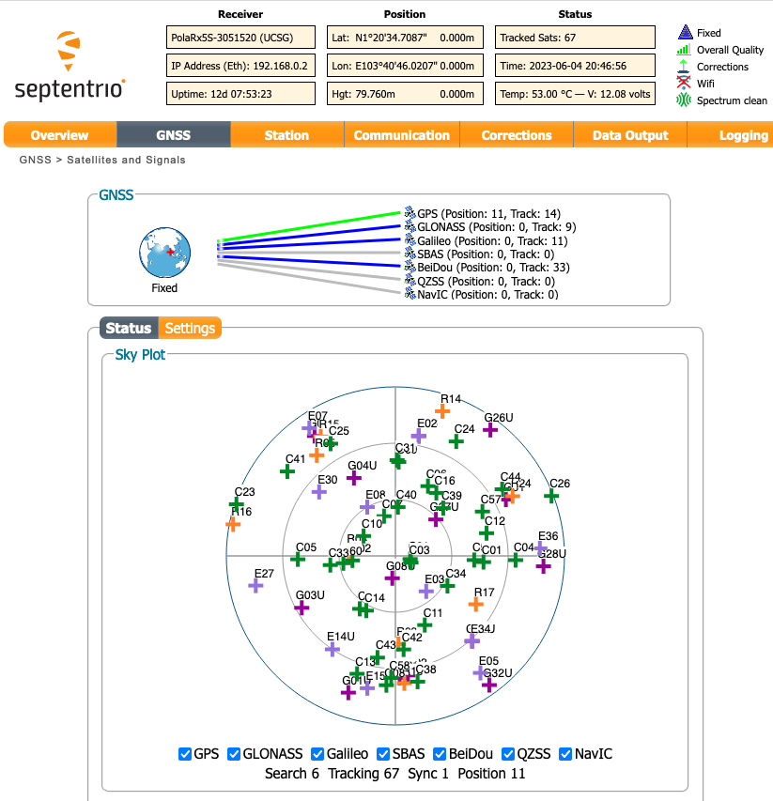
GNSS Receiver Tracking 67 Satellites at Once (UCAR station in Singapore on June 4, 2023)

Slide 10
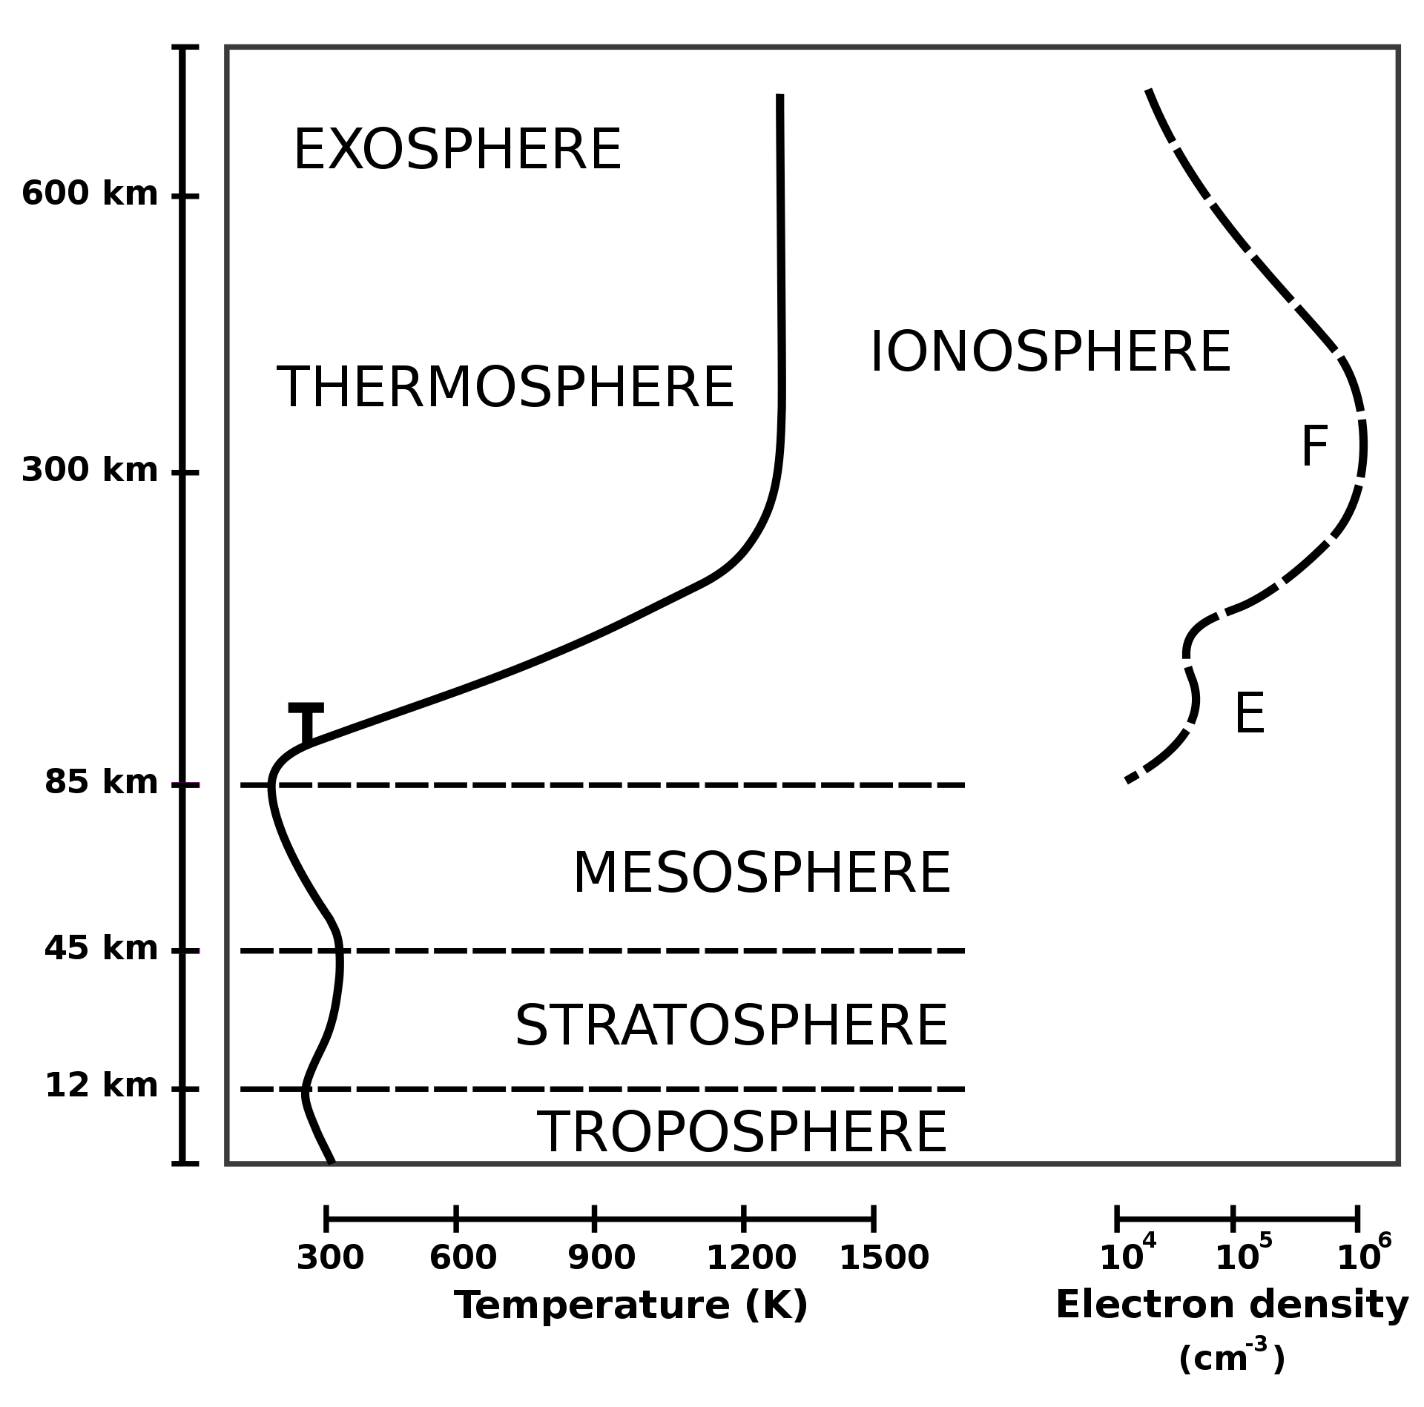
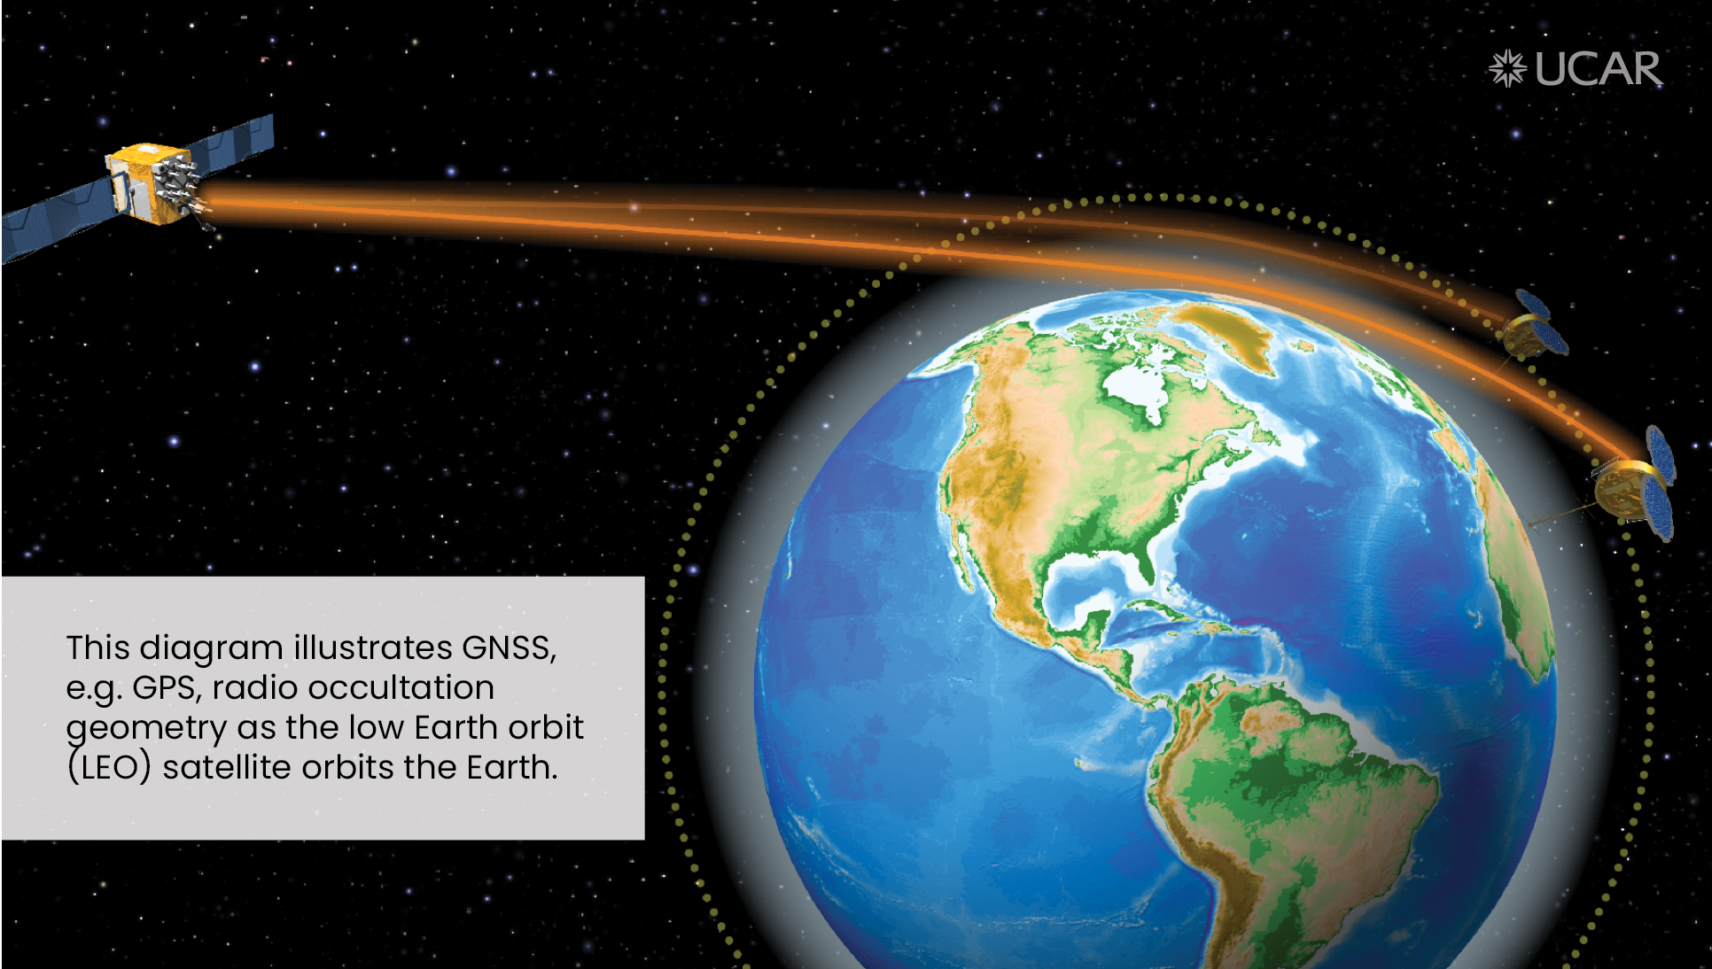
Introduction to Radio Occultation
Radio occultation (RO) technique looks at bending of radio waves traversing an atmosphere
First applied to planetary atmospheres by teams at JPL and Stanford University with Mariner IV spacecraft (Kliore et al., 1965)
COSMIC, NASA, NSF first demonstrated technique on Earth with GPS/MET mission in 1995
Utilizing open Global Navigation Satellite System (GNSS) signals
[ From Wikipedia ]

Slide 11
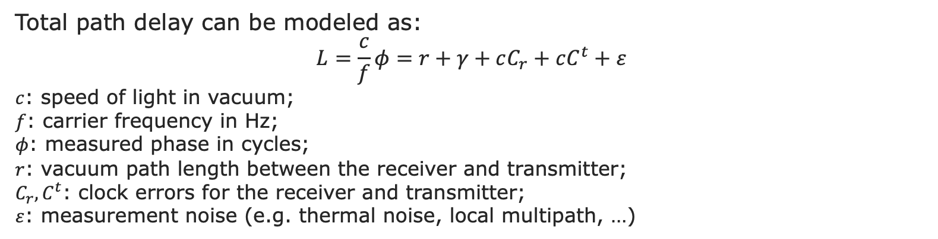
Radio Occultation Measurements
Total path delay can be modeled as:
$$L=\frac{c}{f}φ=r+γ+cC_{r}+cC^{t}+ε$$
$c$: speed of light in vacuum;
$f$: carrier frequency in Hz;
$φ$: measured phase in cycles;
$r$: vacuum path length between the receiver and transmitter;
$C_{r}{, C}^{t}$: clock errors for the receiver and transmitter;
$ε$: measurement noise (e.g. thermal noise, local multipath, …)
excess delay due to the Earth’s atmos
Time delay and ray path bending due to …

Slide 12
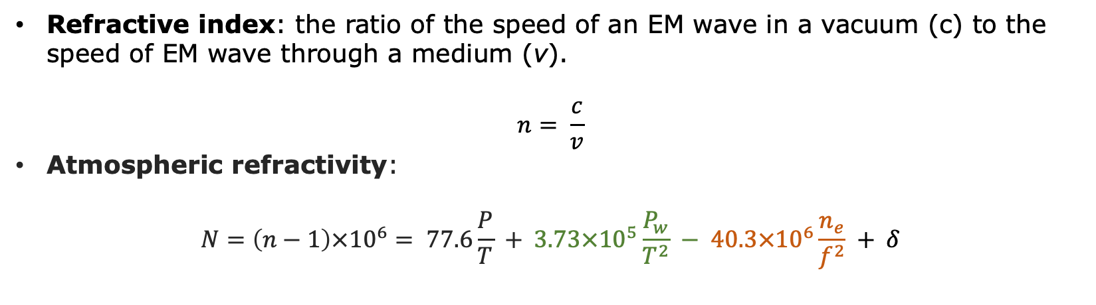
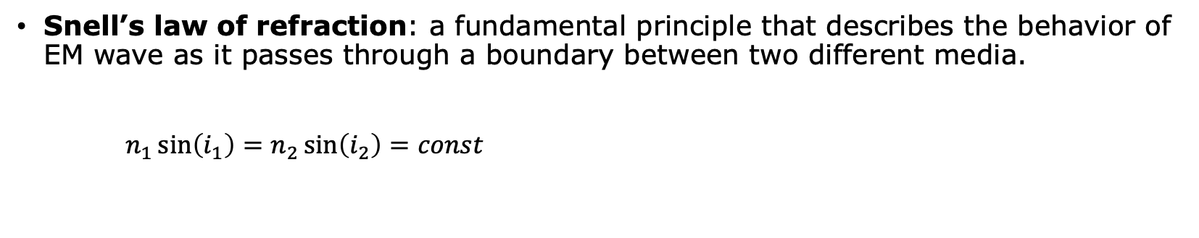
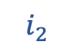
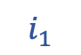
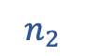
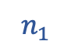
Basic Physics of RO Measurements
Refractive index: the ratio of the speed of an EM wave in a vacuum (c) to the speed of EM wave through a medium (v).
$$n= \frac{c}{v}$$
Atmospheric refractivity:
$$N=\left(n−1\right)×{10}^{6}= 77.6\frac{P}{T} + 3.73×{10}^{5}\frac{P_{w}}{T^{2}} − 40.3×{10}^{6}\frac{n_{e}}{f^{2}} + δ$$
Dry term
Wet term
Ionospheric term
Snell’s law of refraction: a fundamental principle that describes the behavior of EM wave as it passes through a boundary between two different media.
$n_{1}\sin\left(i_{1}\right)=n_{2}\sin\left(i_{2}\right)=const$
$$i_{1}$$
$$n_{1}$$
Horizontal layered
$$i_{2}$$
$$n_{2}$$
Notes:
$P$: atmos pressure in mbar;
$T$: atmos temperature in K;
$P_{w}$: water vapor partial pressure in mbar;
$n_{e}$: electron number density per m³;
$f$: transmitter frequency in Hz.

Slide 13
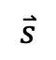
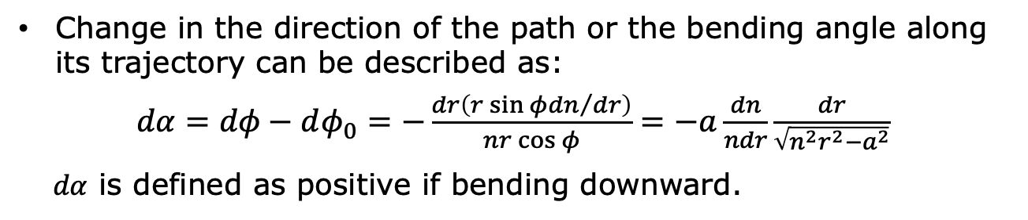
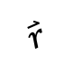
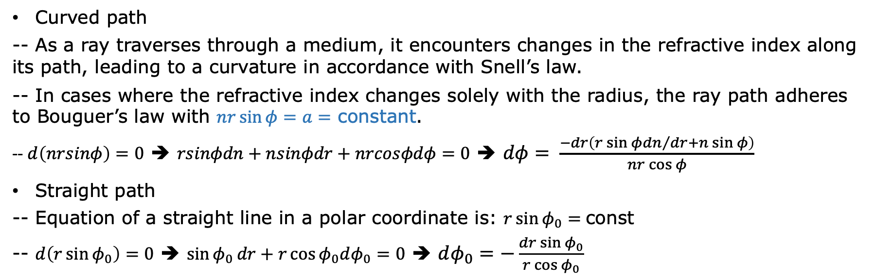
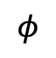
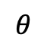
Basic Physics of RO Measurements
Curved path
-- As a ray traverses through a medium, it encounters changes in the refractive index along its path, leading to a curvature in accordance with Snell’s law.
-- In cases where the refractive index changes solely with the radius, the ray path adheres to Bouguer’s law with $nr\sin{φ}=a=$ constant.
-- $d\left(nrsinφ\right)=0$ ➔ $rsinφdn+nsinφdr+nrcosφdφ=0$ ➔ $dφ= \frac{−dr\left(r\sin{φ}{dn}/{dr}+n\sin{φ}\right)}{nr\cos{φ}}$
Straight path
-- Equation of a straight line in a polar coordinate is: $r\sin{φ_{0}}=$const
-- $d\left(r\sin{φ_{0}}\right)=0$ ➔ $\sin{φ_{0}}dr+r\cos{φ_{0}dφ_{0}}=0$ ➔ $dφ_{0}=−\frac{dr\sin{φ_{0}}}{r\cos{φ_{0}}}$
Change in the direction of the path or the bending angle along its trajectory can be described as:
$dα=dφ−dφ_{0}=−\frac{dr\left(r\sin{φ}{dn}/{dr}\right)}{nr\cos{φ}}=−a\frac{dn}{ndr}\frac{dr}{\sqrt{n^{2}r^{2}−a^{2}}}$
$dα$ is defined as positive if bending downward.
$$φ$$
$$\overset{⃑}{s}$$
$$\overset{⃑}{r}$$
Ray path
$$θ$$
Center of curvature

Slide 14
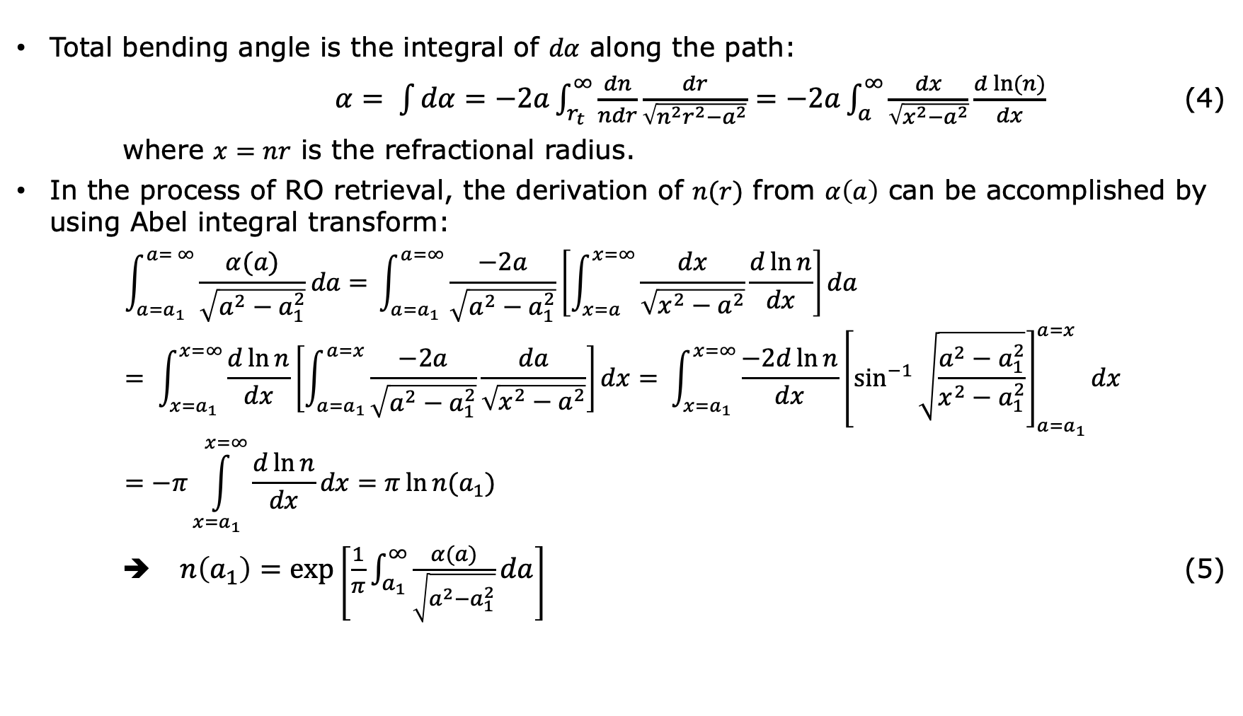
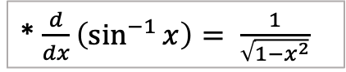
Basic Physics of RO Measurements
Total bending angle is the integral of $dα$ along the path:
$α= \int{dα}=−2a\int_{r_{t}}^{∞}{\frac{dn}{ndr}\frac{dr}{\sqrt{n^{2}r^{2}−a^{2}}}}=−2a\int_{a}^{∞}{\frac{dx}{\sqrt{x^{2}−a^{2}}}\frac{d\ln{(n)}}{dx}}$ (4)
where $x=nr$ is the refractional radius.
In the process of RO retrieval, the derivation of $n(r)$ from $α\left(a\right)$ can be accomplished by using Abel integral transform:
$$\int_{a=a_{1}}^{a= ∞}{\frac{α(a)}{\sqrt{a^{2}−a_{1}^{2}}}da= }\int_{a=a_{1}}^{a=∞}{\frac{−2a}{\sqrt{a^{2}−a_{1}^{2}}}\left[\int_{x=a}^{x=∞}{\frac{dx}{\sqrt{x^{2}−a^{2}}}\frac{d\ln{n}}{dx}}\right]da}= \int_{x=a_{1}}^{x=∞}{\frac{d\ln{n}}{dx}\left[\int_{a=a_{1}}^{a=x}{\frac{−2a}{\sqrt{a^{2}−a_{1}^{2}}}\frac{da}{\sqrt{x^{2}−a^{2}}}}\right]dx}= \int_{x=a_{1}}^{x=∞}{\frac{−2d\ln{n}}{dx}{\left[\sin^{−1}{\sqrt{\frac{a^{2}−a_{1}^{2}}{x^{2}−a_{1}^{2}}}}\right]}_{a=a_{1}}^{a=x}dx}=−π\int_{x=a_{1}}^{x=∞}{\frac{d\ln{n}}{dx}dx}=π\ln{n(a_{1})}$$
➔ $n\left(a_{1}\right)=exp\left[\frac{1}{π}\int_{a_{1}}^{∞}{\frac{α(a)}{\sqrt{a^{2}−a_{1}^{2}}}da}\right]$ (5)
* $\frac{d}{dx}\left(\sin^{−1}{x}\right)= \frac{1}{\sqrt{1−x^{2}}}$
Notes:
Abel transform, similar to Fourier transform, is a mathematical operation used to convert data from one coordinate system to another. However Abel transform finds particular use in the analysis of functions exhibiting spherical or axial symmetry.

Slide 15
Example of excess phase and amplitude measurements
Stratosphere
Ionospheric effect
Troposphere
noise

Slide 16
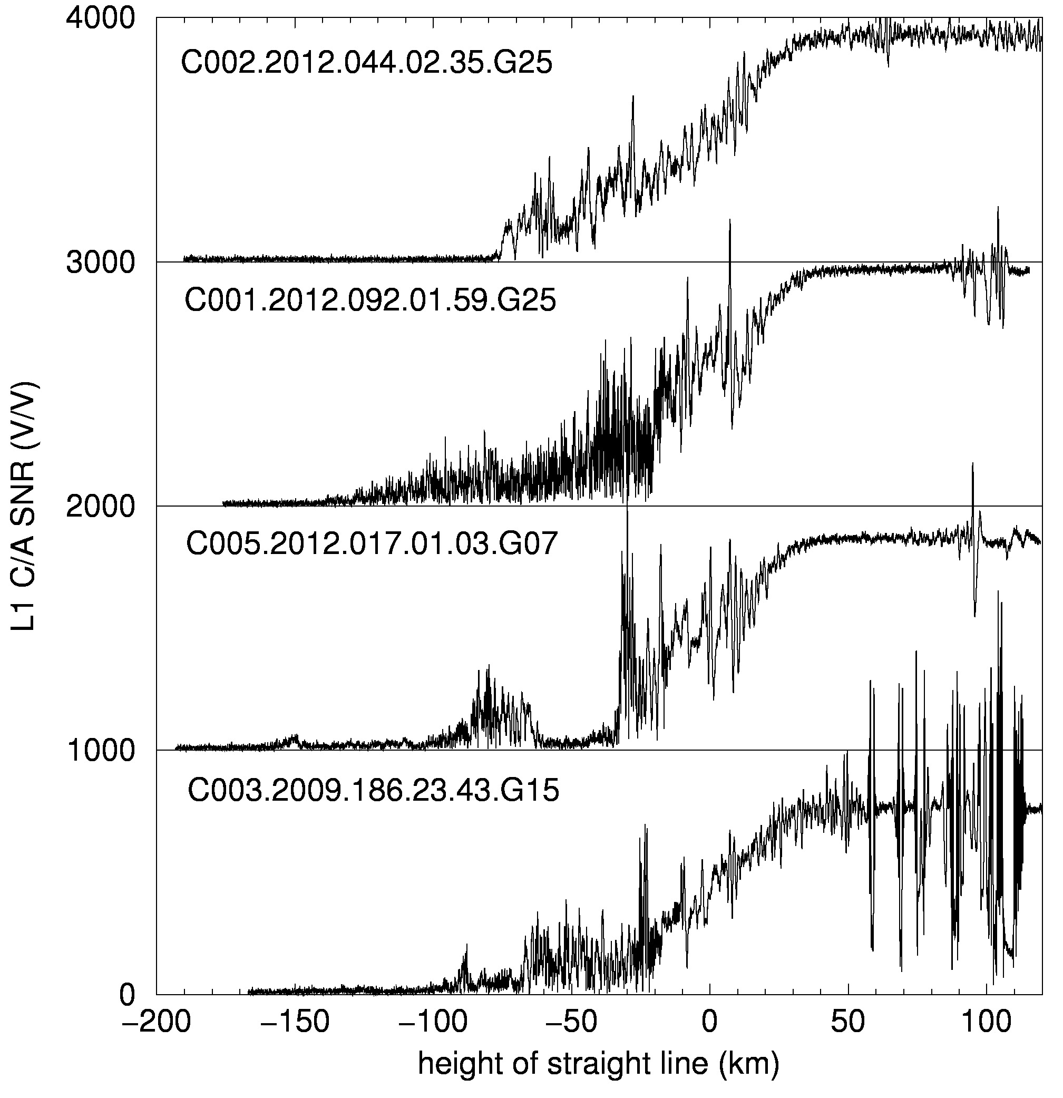
Amplitudes of RO signals; different propagation effects
Polar occultation. Amplitude
fluctuation is not significant.
Abrupt reduction of amplitude
below noise level.
Tropical occultation. Significant
amplitude fluctuation induced by
deep moist convection. Gradual
reduction of amplitude below noise
level.
Sub-tropical occultation. Sharp
ABL top results in deep amplitude
fade due to de-focusing.
Strong amplitude scintillations
induced by the ionospheric
sporadic E-layer.

Slide 17
BA – Wave optics (WO) Method
GO approximation is only applicable in areas where a single ray is detected and often becomes unreliable in the lower troposphere due to the prevalence of multipath caused by sharp changes in N.
WO method considers the diffraction effect and can distinguish the superimposed signals from multiple ray paths. Over years a series of advanced WO methods have developed to retrieve the BA profile in multipath regions.
- back-propagation [Melbourne et al., 1994; Gorbunov et al., 1996]
- radio-optics [Lindal et al., 1987; Hocke et al., 1999, Sokolovskiy, 2001]
- canonical transform (CT) [Gorbunov, 2002]
- full spectrum inversion (FSI) [Jensen et al., 2003]
- phase matching (PM) [Jensen et al., 2004]
- CT of the second type (CT2) [Gorbunov and Lauritsen, 2004]
- modified CT2 (CT2A) [Gorbunov et al., 2021]
Different WO methods are based on different assumptions about the satellite orbits and result in different computational costs.
PM method, which is directly applicable to arbitrary satellite orbits, is considered to be the most accurate one.

Slide 18
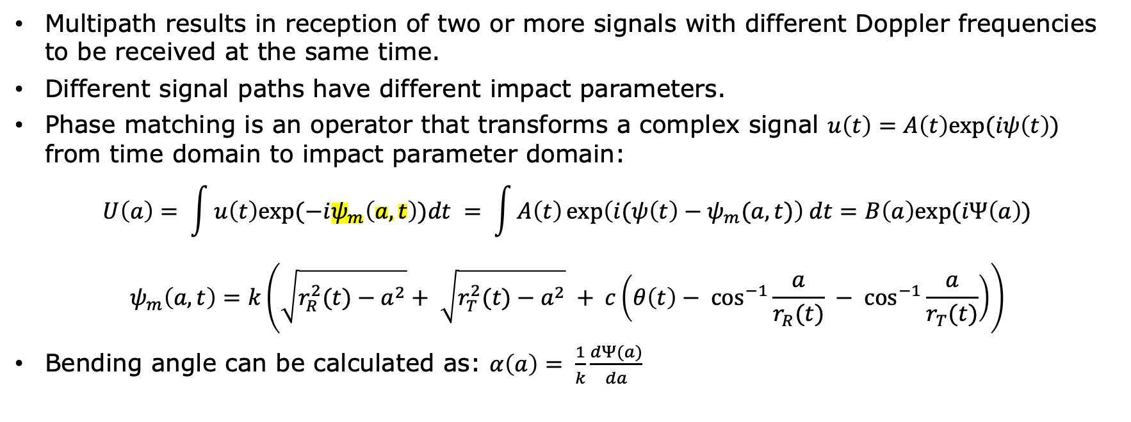
BA – Phase Matching (PM) Method
Multipath results in reception of two or more signals with different Doppler frequencies to be received at the same time.
Different signal paths have different impact parameters.
Phase matching is an operator that transforms a complex signal $u\left(t\right)=A\left(t\right)exp⁡(iψ\left(t\right))$ from time domain to impact parameter domain:
$$U\left(a\right)= \int{u\left(t\right)exp⁡(−iψ_{m}\left(a,t\right))dt} = \int{A\left(t\right)\exp\left(i(ψ\left(t\right)−ψ_{m}(a,t)\right) dt}=B\left(a\right)exp⁡(iΨ\left(a\right))$$
$$ψ_{m}\left(a,t\right)=k\left(\sqrt{r_{R}^{2}(t)−a^{2}}+ \sqrt{r_{T}^{2}(t)−a^{2}} + c\left(θ\left(t\right)− \cos^{−1}{\frac{a}{r_{R}(t)} − \cos^{−1}{\frac{a}{r_{T}(t)}}}\right)\right)$$
Bending angle can be calculated as: $α\left(a\right)= \frac{1}{k}\frac{dΨ(a)}{da}$
$$t_{1}$$
$$φ$$
$$t_{2}$$
$$a$$
r
$$r_{R}$$
GNSS
$$r_{T}$$
LEO
Center of local curvature
EARTH
Notes:
Matching phase can be viewed as an approximation to the true optical ray path: two straight lines starting at the LEO and GNSS positions, and connected by a circular arc between them (radius of c and size of …).
BA can be calculated by the derivative of the phase of the transformed field.

Slide 19
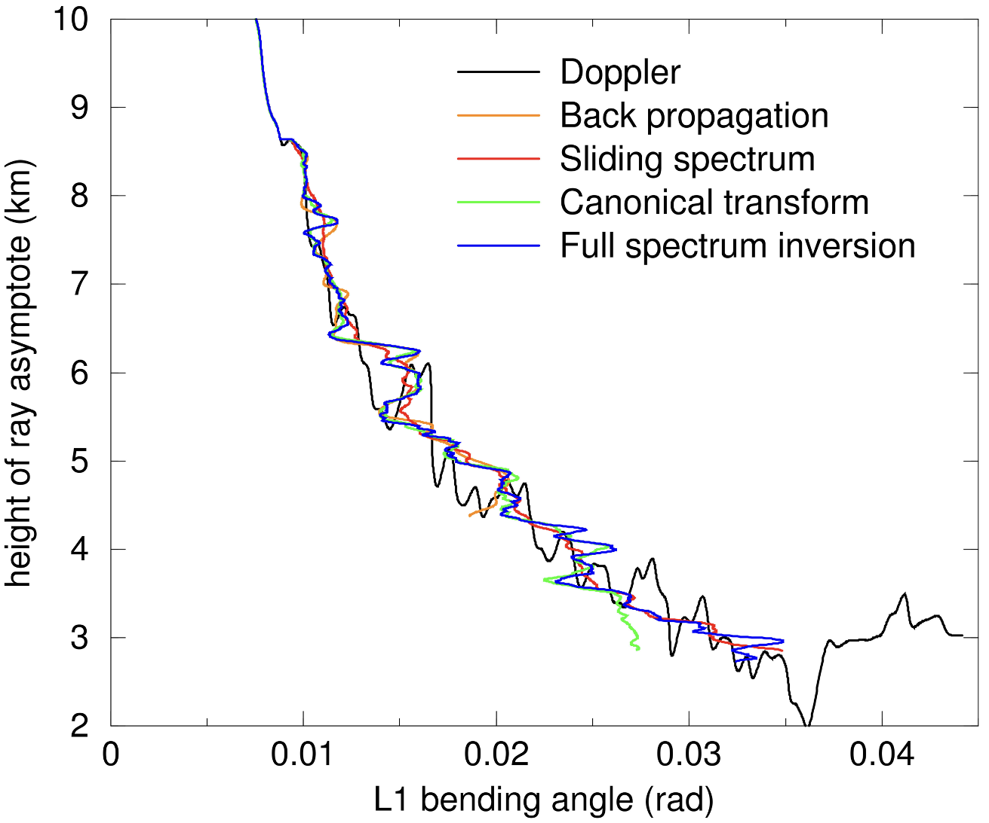
Comparison of GO and WO Methods
Under conditions of the multipath propagation,
GO retrieved BA becomes a multi-valued function of the impact height.
Four WO inversions show consistent results. The retrieved BAs are single-valued functions of the impact height.
WO methods successfully disentangle the multipath in spherically symmetric refractivity.
[Kuo et al., 2004]
WO methods solve for diffraction effects, which allows ~0.1 km vertical resolution at all heights.
GO method is applied above 20 km;
WO method is used below 20 km.

Slide 20
Spherically symmetric atmosphere
Optimal estimation (Sokolovskiy and Hunt, 1996; Wee and Kuo, 2014; Wee, 2018, Wee et al., 2022)
S₁, S₂
Excess phases of L1 and L2
Satellite Orbits
⍺₁, ⍺₂
Bending angles of L1 and L2
GO (Single path)
WO (Multipath)
⍺
Bending angle
S₁, S₂,
a₁, a₂
Ionospheric correction
N
Refractivity
Excess phases and amplitudes of L1 and L1
High altitude climatology & Abel inversion
Optimal estimation
T, e, P
Auxiliary meteorological data
[Rocken et al., 2004]

Slide 21
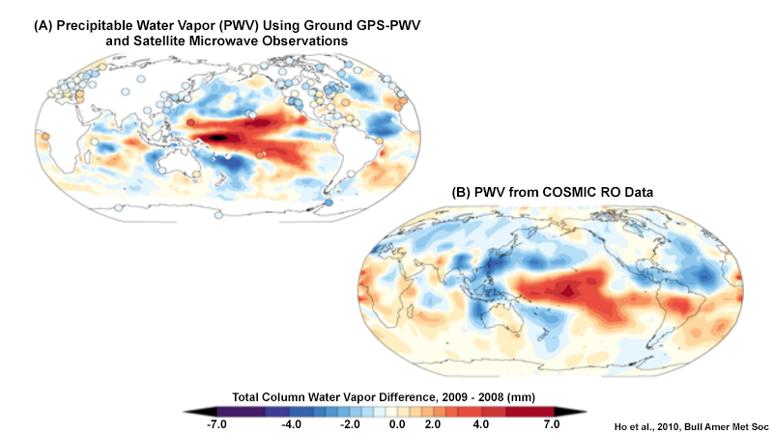
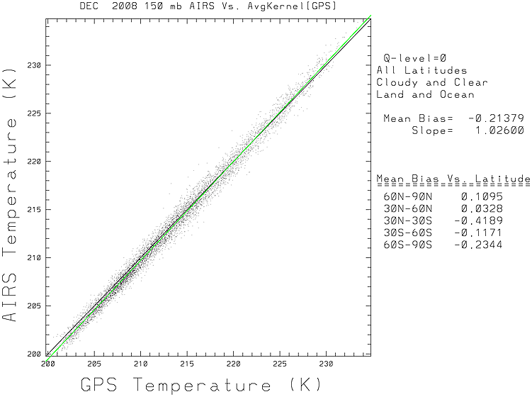
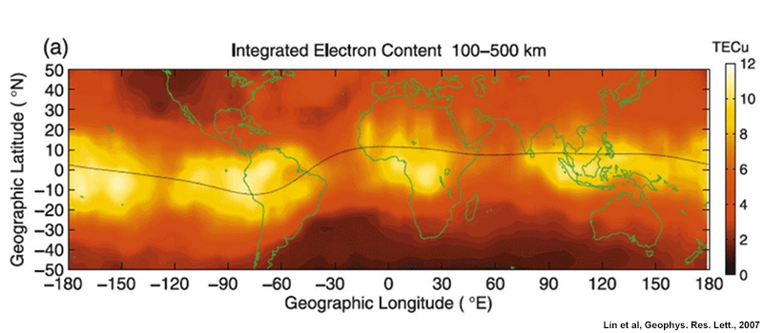
Scientific Uses of RO Data Products
Weather
Improve global weather analyses, particularly over data sparse regions such as the oceans, tropics, and polar regions
Increase accuracy of numerical weather model forecasts
Improve understanding of tropical, mid-latitude and polar weather systems and their interactions
Climate
Monitor climate change and variability with unprecedented accuracy – “World’s most accurate, precise, and stable thermometer from space!” (Rick Anthes)
Evaluate global climate models and reanalyses
Calibrate infrared and microwave sensors and retrieval algorithms
Ionosphere and space weather
Observe global electronic density distribution
Improve the analysis and prediction of space weather
Improve monitoring/prediction of scintillation (e.g. equatorial plasma bubbles, sporadic E clouds)

Slide 22
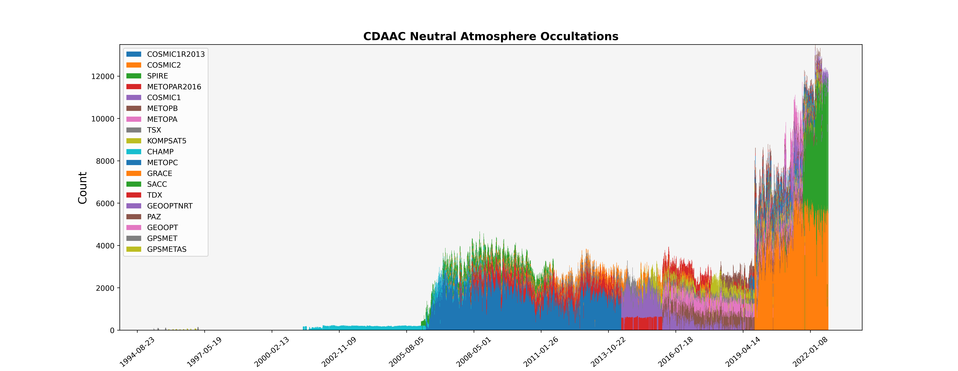
A Brief COSMIC History and RO
COSMIC-2, Commercial,
& Friends
COSMIC-1 & Friends
GPS/MET (look closely)
CHAMP
Courtesy M. Perrotta, UCAR

Slide 23
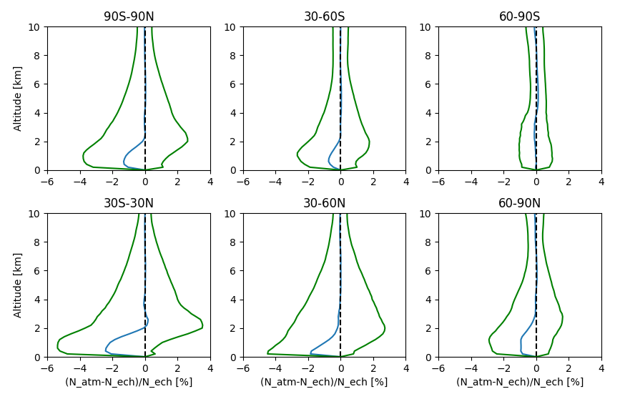
Statistical comparison of N between RO and Model
July 2007

Slide 24
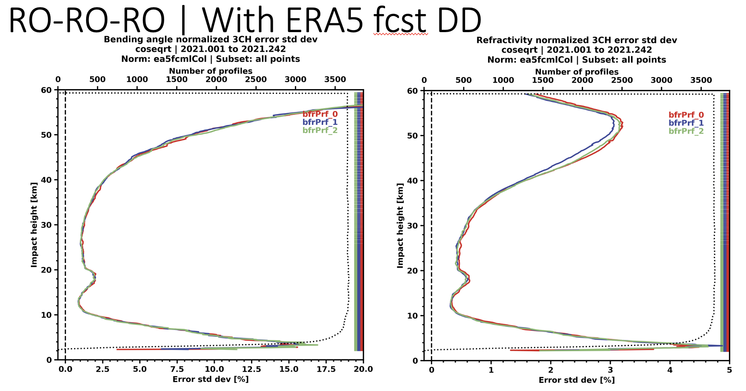
Dominant source of RO uncertainties
Residual ionosphere errors
GNSS and LEO clock errors
SNR has an effect
3CH C2 (RO-RO-RO)
January-August 2021
BA
N
Horizontal gradients of T
and footprint effects (small)
Horizontal inhomogeneities of N,
with q dominant in lower
troposphere. SNR has little effect.

Slide 25
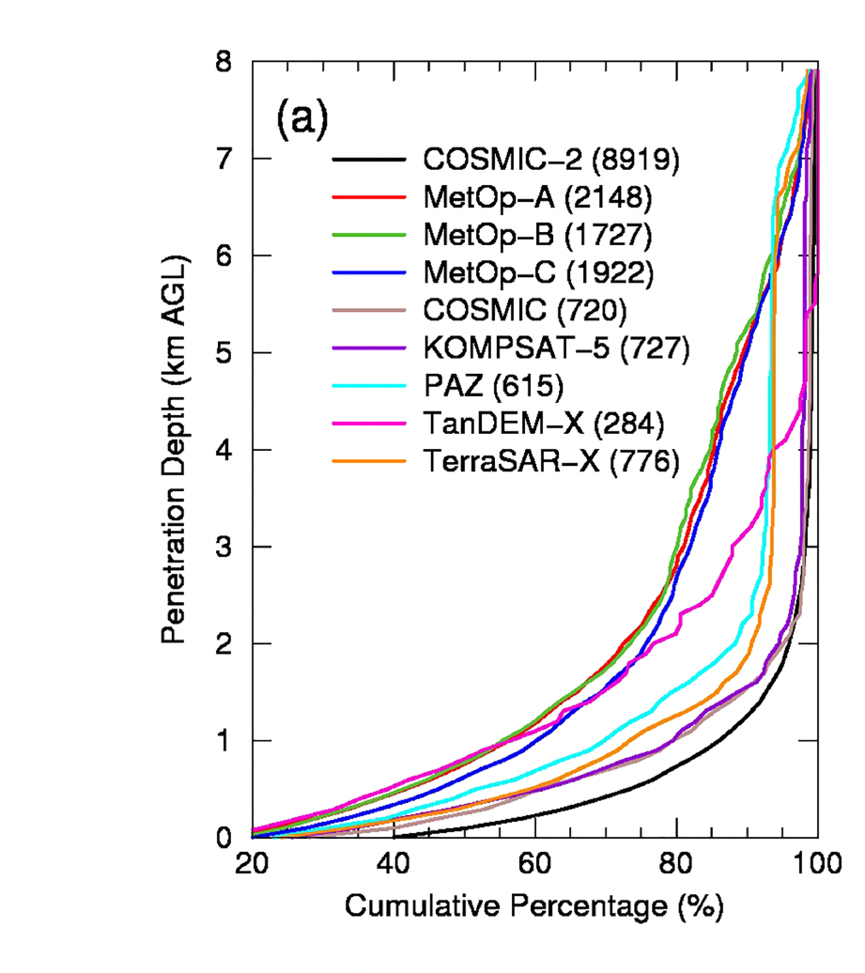
Advantages of High SNR: Penetration Depth
All data processed by CDAAC
(MetOp processing has some
decoding issues; we are investigating)
COSMIC-2
Schreiner et al. GRL 2020

Slide 26
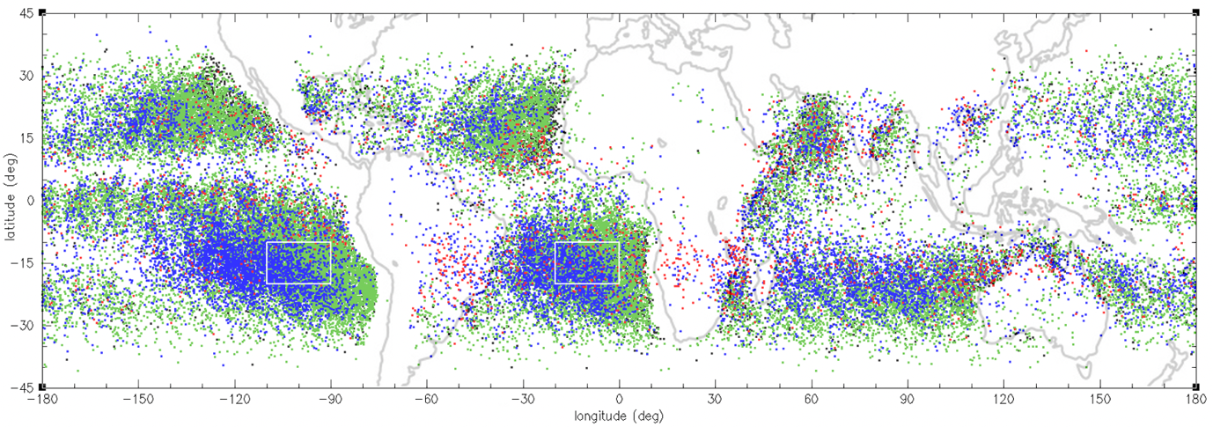
Global map of Super Refraction detected from COSMIC-2 deep signals (June 2020-2021)
Strong dependence of SR detection rate on the SNR
height < 1km 1km < height < 2km 2km < height < 3 km height > 3km
1
2
Sokolovskiy et al., JTECH 2022

Slide 27
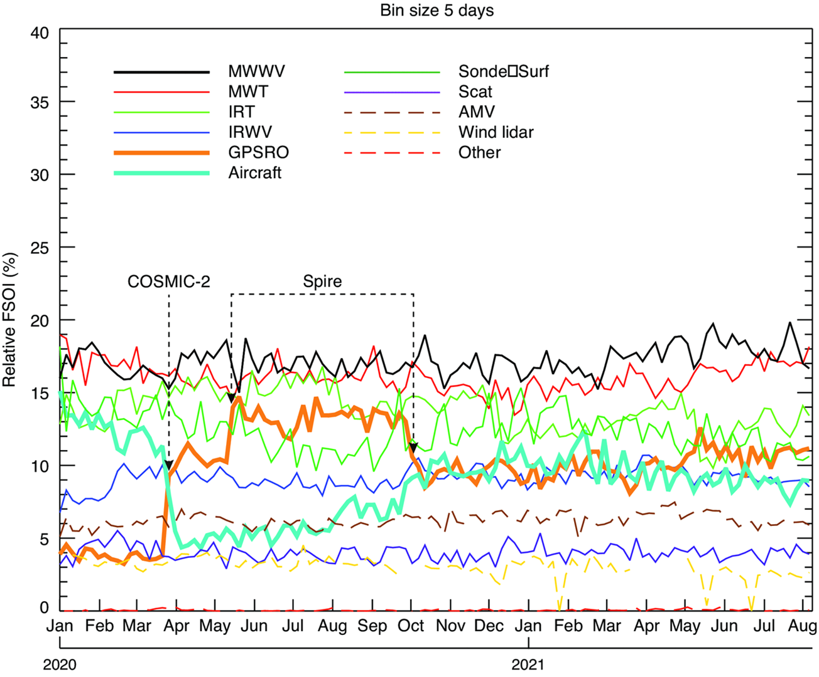
Increase of RO has huge impact on ECMWF operational modeI.
FSOI is an overall forecast skill that is useful for comparing the relative impact of different observational systems.
A fair comparison of the
relative impact of these
observing systems by
his metric over this
period of time. FSOI has
been shown to give
similar results to data
denial experiments,
OSSEs, and Ensembles of
Data Assimilation (EDA)
experiments.
MWWV
MWT
IRT
IRWV
RO
Aircraft
Sonde/sfc
Scatterometer
AMV
Wind lidar
Other
COVID
Sean Healy, ECMWF
Notes:
Relative measure of impact of systems by this metric. Sum of all curves equals 100%

Slide 28
Advanced 1D-Var retrieval of temperature and water vapor from RO (“wetPf2” in CDAAC)
RO gives bending angle (BA) and refractivity (N) profiles, useful in DA
Forecasters and many researchers interested in temperature and water vapor, not BA and N
N function: temperature (T) water vapor pressure (e) and pressure (p)
N = 77.6 (p/T) + 3.73 10⁵ (e/T²)
T, e and p can be computed using a 1D variational method (1D-Var) using T and e from another data source (typically a model) as a first guess and minimizing the errors in a statistical sense.
Tae-Kwon Wee et al. 2022, Atmosphere (just accepted)

Slide 29
1D-Var water vapor compared to ECMWF
1st guess compared to ECMWF 1D-Var compared to ECMWF
Demonstrates the benefit that C2 could bring to NWP below 4 km.
July 16, 2019 – Feb 1, 2020
Notes:
July 16, 2019-Feb 1, 2020

Slide 30
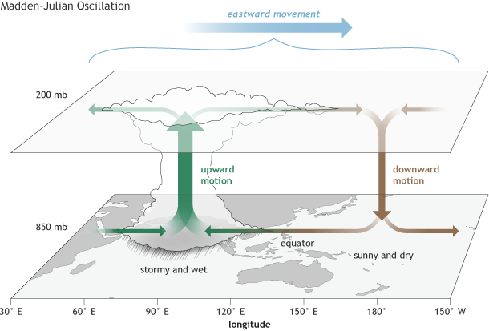
Madden-Julian Oscillation Observed by COSMIC-2
Large-scale propagating convective system
Dominant mode of intraseasonal variability in tropics
Begins Indian Ocean and moves eastward ~5 m/s
Large influence on weather and climate
Poorly represented in climate models
Few observations in cloudy tropics
RO is more accurate and has higher vertical
resolution than any other global observing system
COSMIC-2 has enough observations in tropics to
study individual events.
Source: Climate.gov drawing by Fiona Martin

Slide 31
Vertical Structure of MJO Temperature Anomaly revealed by COSMIC-2
Phase (time)
C2 temperature (T) and specific humidity (Q) from wetPf2 boreal winters during 2019-2022
Detailed fine-scale structure of equatorial T near tropopause is not well captured by any other data.
Enhanced Convection
30-60 days

Slide 32

Vertical Structure of MJO Moisture Anomaly revealed by COSMIC-2
Positive moisture anomalies propagate eastward along with convection from the Indian
ocean to the central Pacific.

Slide 33
Acknowledgements
Introduction to GPS and GNSS
Presentation courtesy of https://ntrs.nasa.gov/citations/20170004590
With minor updates by J. Weiss, UCAR
Physics of atmospheric microwave propagation and RO Retrievals
Sergey Sokolovskiy and Zhen Zeng UCAR/UCP/COSMIC
RO applications and errors
Richard Anthes

Slide 34
References
Born and Wolf, 1999: Principles of Optics, Cambridge Univ. Press, New York.
Gorbunov et al., 1996: Advanced algorithms of inversion of GPS/MET satellite data and their application to reconstruction of temperature and humidity, Rep. 211, Max-Planck Institute for Meteorology, Hamburg, Germany.
Gorbunov et al., 2002: Canonical transform method for processing radio occultation data in lower troposphere, doi: 10.1029/2000RS002592.
Gorbunov and Lauritsen, 2004: Canonical transform methods for radio occultation data, doi: 10.1007/978-3-662-09041-1_6.
Gorbunov et al., 2021: Generalized canonical transform method for radio occultation sounding with improved retrieval in the presence of horizontal gradients, doi: 10.5194/amt-14-853-2021.
Hajj et al., 2002: A technical description of atmospheric sounding by GPS occultation, doi: 10.1016/S1364-6826(01)00114-6.
Hocke et al., 1999: Radio occultation data analysis by the radioholographic method, doi: 10.1016/S1364-6826(99)00080-2.
Jensen et al., 2003: Full spectrum inversion of radio occultation signals, doi: 10.1029/2002RS002763.
Jensen et al., 2004: Geometrical optics phase matching of radio occultation signals, doi: 10.1029/2003RS002899.
Kuo et al., 2004: Inversion and error estimation of GPS radio occultation data, doi: 10.2151/jmsj.2004.507.

Slide 35
References
Kursinski, et al., 1997: Observing Earth’s atmosphere with radio occultation measurements using the Global Positioning System, doi: 10.1029/97JD01569.
Liu et al., 2018: A quality control procedure based on bending angle measurement uncertainty for radio occultation data assimilation in the tropical lower troposphere, doi: 10.1175/JTECH-D-17-0224.1.
Lohmann, 2005: Application of dynamical error estimation for statistical optimization of radio occultation bending angles, doi: 10.1029/2004RS003117.
Melbourne et al., 1994: The application of spaceborne GPS to atmospheric limb sounding and global change monitoring, JPL, Pasadena, CA, USA.
Syndergaard, 1998: Modeling the impact of the Earth’s oblateness on the retrieval of temperature and pressure profiles from limb sounding, doi: 10.1016/S1365-6826(97)00056-4.
Sokolovskiy and Hunt, 1996: Statistical optimization approach for GPS/MET data inversion, in URSI GPS/MET Workshop, Union Radio Sci. Int., Tuscon, Ariz.
Sokolovskiy, 2001: Modeling and inverting radio occultation signals in the moist troposphere, doi: 10.1029/1999RS002273.
Sokolovskiy et al., 2005: Assessing the accuracy of a linearized observation operator for assimilation of radio occultation data: Case simulations with a high-resolution weather model, doi: 10.1175/MWR2948.1.

Slide 36
References
Sokolovskiy et al., 2009: Optimal noise filtering for the ionospheric correction of GPS radio occultation signals, doi: 10.1175/2009JTECHA1192.1.
Sokolovskiy et al., 2009: Postprocessing of L1 GPS radio occultation signals recorded in open-loop mode, doi: 10.1029/2008RS003907.
Sokolovskiy et al., 2010: On the uncertainty of radio occultation inversions in the lower troposphere, doi: 10.1029/2010JD014058
Sokolovskiy et al., 2014: Observation, analysis, and modeling of deep radio occultation signals: Effects of tropospheric ducts and interfering signals, doi: 10.1002/2014RS005436.
Wee and Kuo, 2014: Advanced stratospheric data processing of radio occultation with a variational combination for multifrequency GNSS signals, doi: 10.1002/2014JD022204.
Wee, 2018: A variational regularization of Abel transform for GPS radio occultation, doi: 10.5194/amt-11-1947-2018.
Zeng et al., 2016: Ionospheric correction of GPS radio occultation data in the troposphere, doi: 10.5194/amt-9-335-2016.

